Slide 1



Hospitality Project
View in Power BI
Last data refresh:
8/3/2023 11:20:37 PM UTC
Downloaded at:
8/3/2023 11:23:11 PM UTC

Slide 2
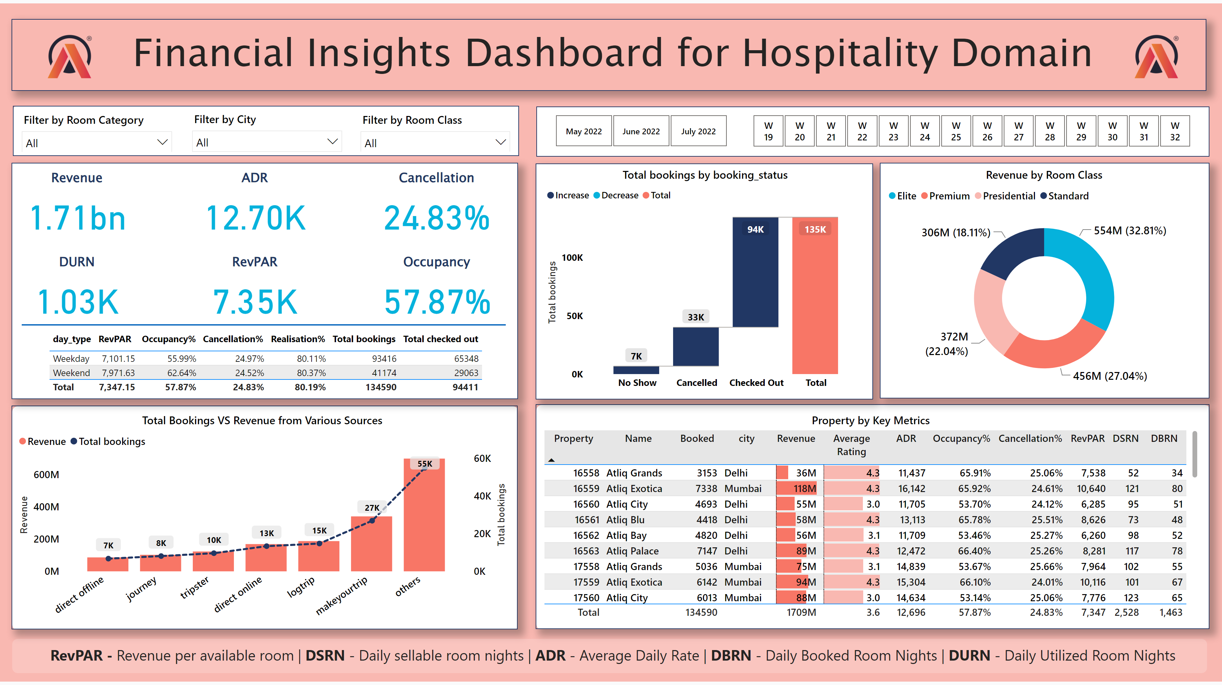
Dashboard
Notes:
Property by Key Metrics
No alt text provided
Revenue
No alt text provided
textbox
No alt text provided
image
No alt text provided
shape
No alt text provided
image
No alt text provided
slicer
No alt text provided
Filter by City
No alt text provided
slicer
No alt text provided
shape
No alt text provided
slicer
No alt text provided
slicer
No alt text provided
Total Bookings VS Revenue from Various Sources
No alt text provided
shape
No alt text provided
textbox
No alt text provided
Cancellation
No alt text provided
ADR
No alt text provided
DURN
No alt text provided
RevPAR
No alt text provided
Occupancy
No alt text provided
tableEx
No alt text provided
shape
No alt text provided
waterfallChart
No alt text provided
shape
No alt text provided
shape
No alt text provided
Revenue by Room Class
No alt text provided
shape
No alt text provided
shape
No alt text provided
shape
No alt text provided
shape
No alt text provided

Slide 3
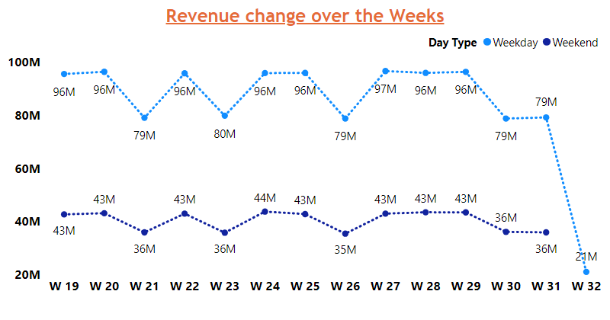
Revenue TT
Notes:
Revenue change over the Weeks
No alt text provided

Slide 4
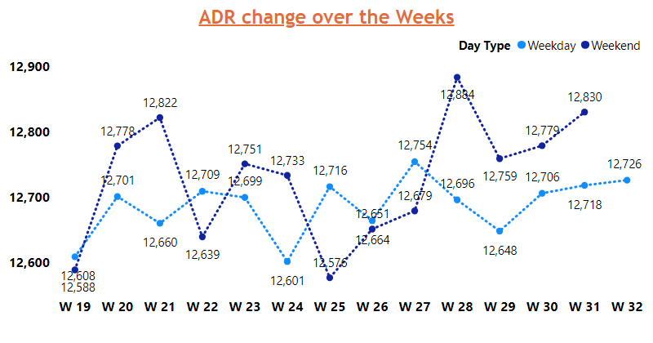
ADR TT
Notes:
ADR change over the Weeks
No alt text provided

Slide 5
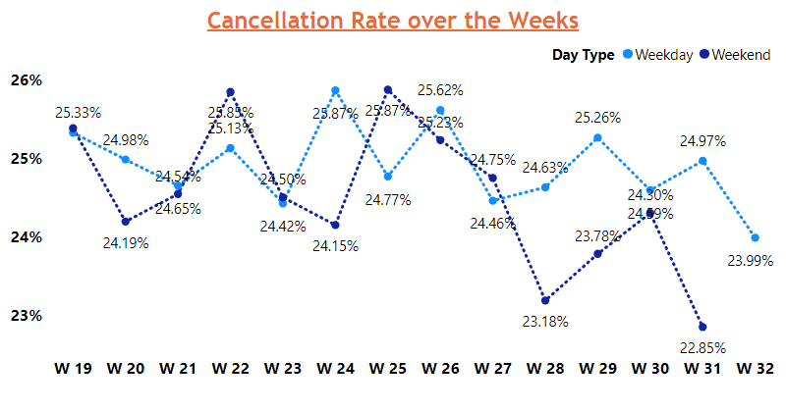
Cancellation TT
Notes:
Cancellation Rate over the Weeks
No alt text provided

Slide 6
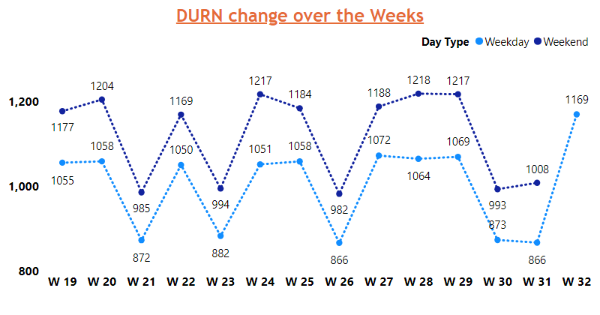
DURN TT
Notes:
DURN change over the Weeks
No alt text provided

Slide 7
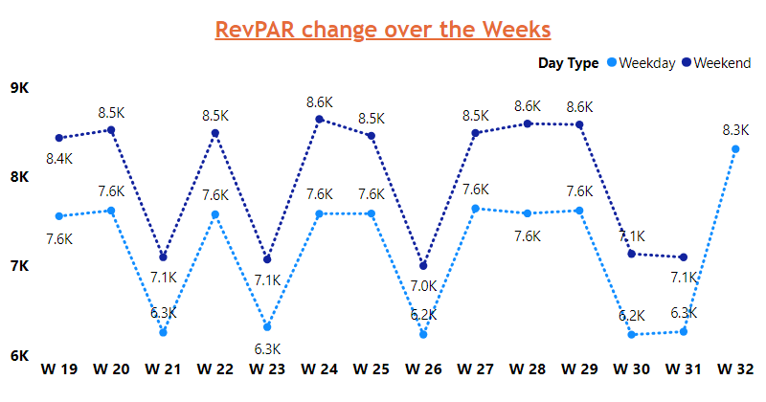
RevPAR TT
Notes:
RevPAR change over the Weeks
No alt text provided

Slide 8
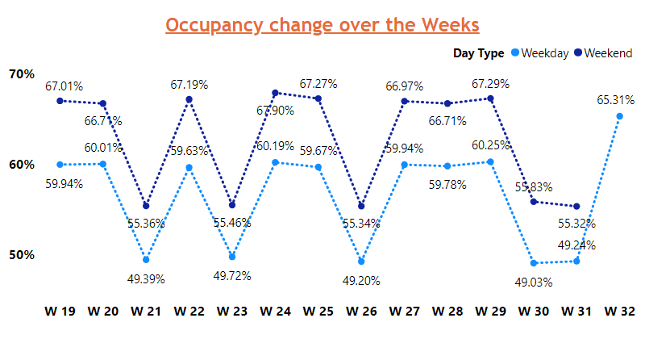
Occupancy TT
Notes:
Occupancy change over the Weeks
No alt text provided

